Slide 1
Education
For students. By students.
Group Members:
Tjong Jia Ning S10205022
Edward Neo S10204829
Kwok Yan Shan S10204682
Rachel Yeo S10203123
Notes:
Yan Shan - Good Morning lecturers! Today, My team and I will be presenting on the idea we came out with for our Assessment. The topic my team and I were assigned to is Education, and our area of focus is Home-based Learning.

Slide 2
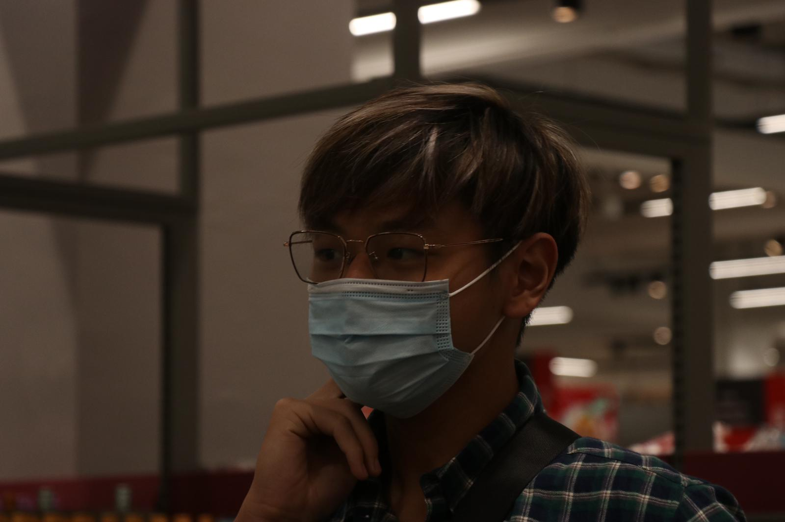
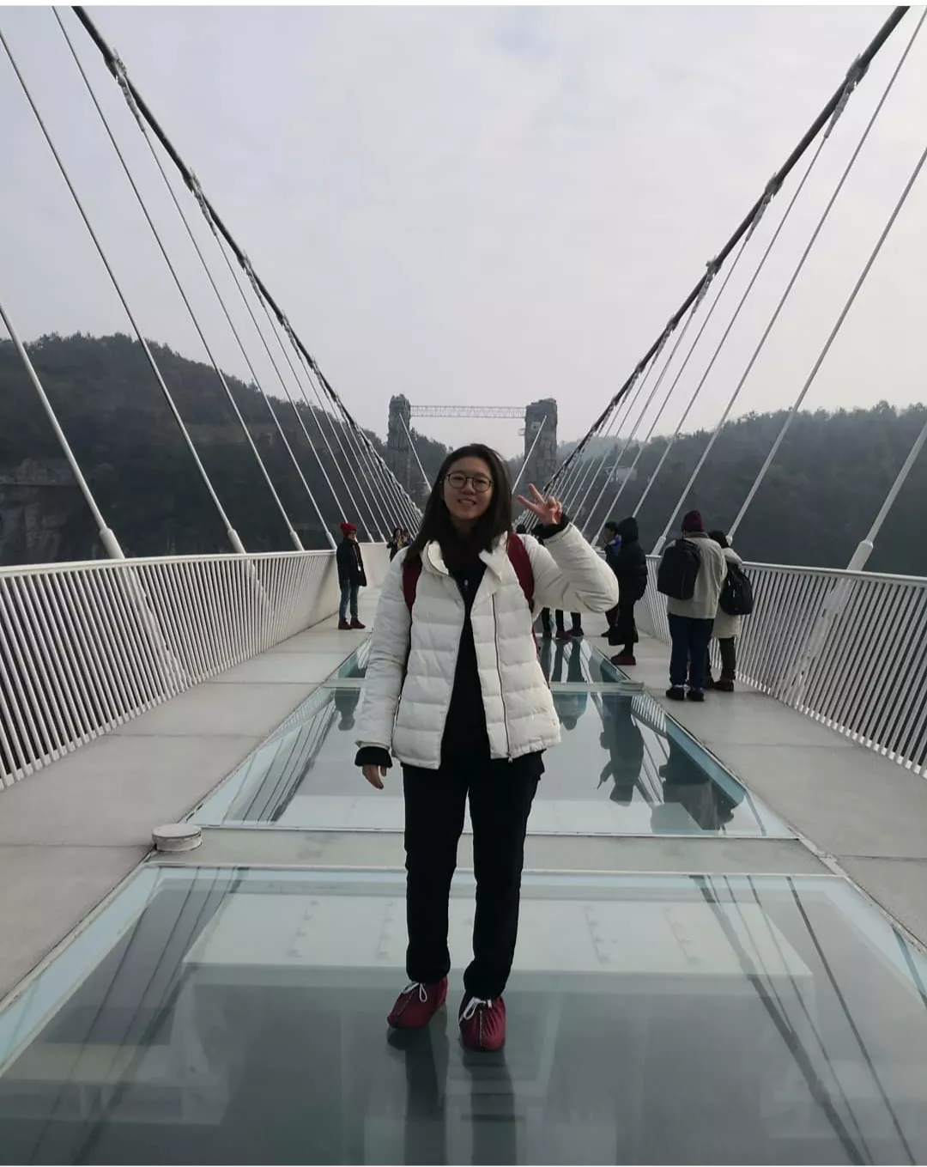
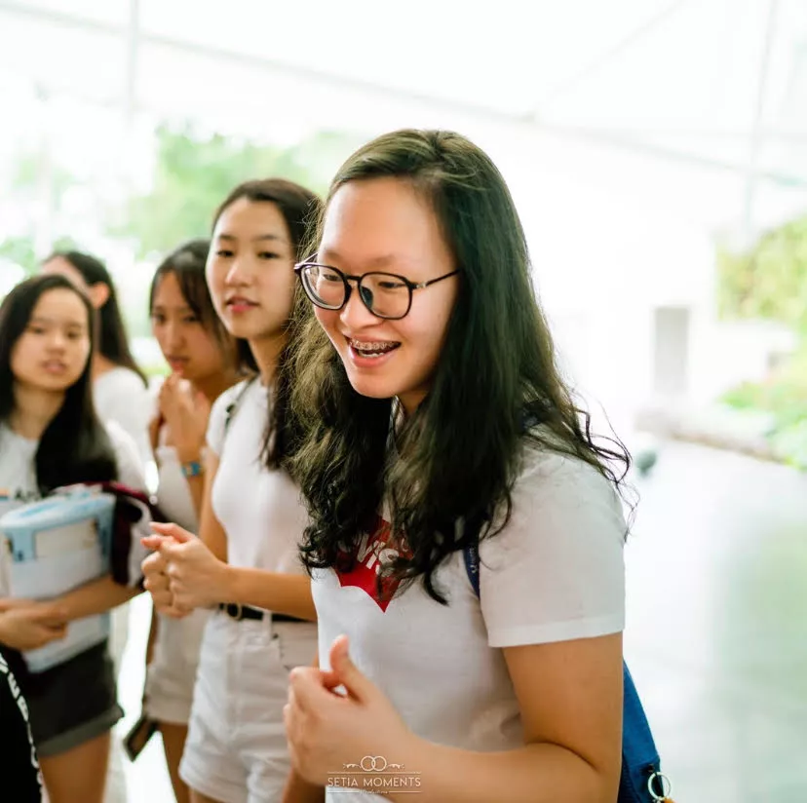
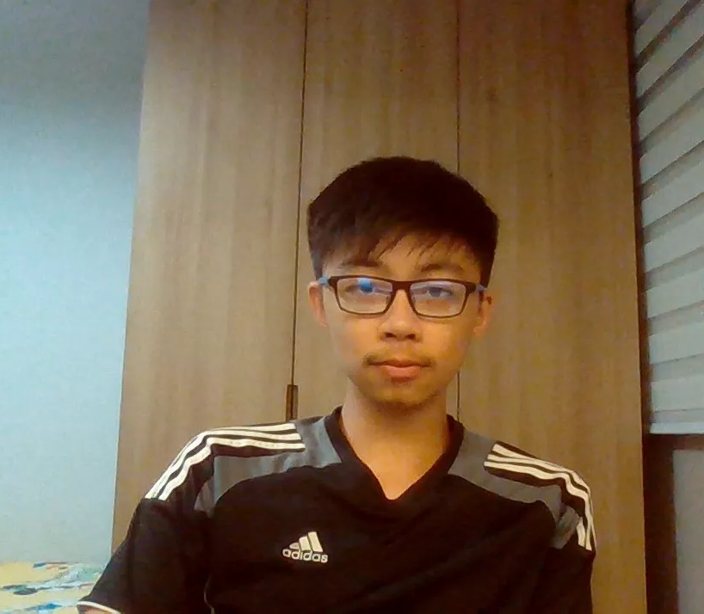
WHO ARE WE?
03
01
04
02
Edward
Rachel
Yan Shan
Jia Ning
Notes:
Yan Shan- Before we move on, who are we? Well Our Team name is called “MEL” also known as Making Effective Learning. I am Yan Shan and my fellow group mates are Rachel, Jia Ning, and Edward.

Slide 3
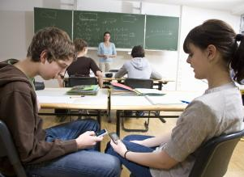
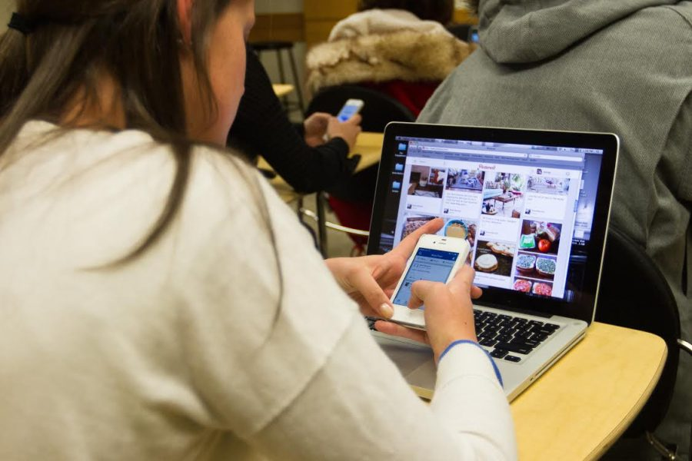
Distractions
A 2016 study by the University of Nebraska-Lincoln found that college students check their devices an average 11 times a day while in class
Notes:
Yan Shan - After our observations and interviews, we have identified many pain points and realised that many of the pain points identified points towards the same issue, distractions. Did you know that distractions are a thing commonly faced by students not only in Singapore, but around the whole world as well? Based on a 2016 study by the University of Nebraska-Lincoln, it was found that college students check their devices an average of 11 times a day while in class, and this was conducted when there was no pandemic and HBL. Can you imagine the amount of distractions one can have now at home during this current period, especially when there is no rules and no one physically there to supervise them.
Left Image - https://www.lexialearning.com/blog/how-phones-can-increase-learning-all-types-students
Right Image - https://naeye.net/2435/opinion/technology-temptation-or-teacher/
Statistics - https://www.statepress.com/article/2017/09/classroom-distractions-stories-statistics-and-solutions#:~:text=There%20are%20many%20types%20of%20distractions%20students%20experience.&text=A%202016%20study%20by%20the,availability%20of%20phones%20and%20laptops.

Slide 4
OUR OPPORTUNITY STATEMENT
How might we help students stay engaged and focus, as well as give them a conducive environment to study in.
Notes:
Yan Shan- With this in mind, we have decided on our final opportunity statement and that is, “How might we help students stay engaged and focus to give them a conducive learning environment to study in”.

Slide 5
Pain Points
Unconducive environment
Social Media & Games
The wifi connection is bad and some do not have a proper place to study at.
Students may get bored and start browsing through social media or even start to play games to pass time.
Bad Time Management
Siblings
Students have bad time management and often can't finish their assignment
More people at home means more noise and distractions.
Notes:
Yan Shan - These are some of the pain points observed from our interviews. Students may have unconducive environments due to bad Wifi connection and some may not have a proper place to study in. Furthermore, social Media and games serve as a distraction to students as students may get bored in class and start browsing through social media or even play games to pass time. Such distractions may also cause students to have bad time management, thus resulting in them often unable to finish their assignment on time, which will further affect their grades. Siblings and parents at home may affect students since there is more noise and distractions from them. I will now pass on the time to Jia NIng to share about our solutions
https://www.youth.gov.sg/Our-Voice/Opinions/2020/4/What-Singaporean-students-think-of-home-based-learning article

Slide 6
OUR SOLUTION
Notes:
Jia Ning - After observing and discussing with our users. we have decided that to really maximise the student’s study experience, we came up with two ideas, a study pod and a study app, we plan to merge these two ideas together as one solution as we feel that the 2 ideas together can really help the students have a more efficient study experience.

Slide 7
STUDY POD
Notes:
. Jia Ning so first of all we have our study pod!

Slide 8
WHAT IS AVAILABLE
snacks
Number of people
Conducive environment
Charging Port
A vending machine for food and drinks will be located outside every pod
You can have up to 8 people in one box
Air-con and fan is provided. Fast and secure wifi connection is also available in every pod
Charging ports will be provided to allow students to charge their electronic devices
Notes:
Jia Ning - So what is available in the study pod? Firstly we have aircon, fan and wifi provided! We’ve noticed that across the different perspectives, the common concern is that the wifi connection at home and this does affect the students when they are doing Home-based learning as they are not able to hear the teacher clearly. Thus a fast and secure wifi connection is provided to ensure that the connection is not going to be a problem to the students. Secondly, this pod can hold up to as many as 8 students. AT this point, You may be wondering why are we allowing so many students in one pod, they could be distracting each other? However we understand that every student has different studying methods, some might need friends around to help them focus better while others must study in isolation thus our pod is flexible as you book for 1 or for up to 8 students. In addition we feel that this pod can be used for mentor sessions where the seniors can study with the juniors in the pod and help the juniors when they are in need. We also provide charging ports in the pod so that students can charge their electronic devices. Last but not least we will be placing a vending machine outside the pod so that when the students need a quick snack break they can find it right outside the pod. Which in turn reduces the time wasted to travel to find food.

Slide 9
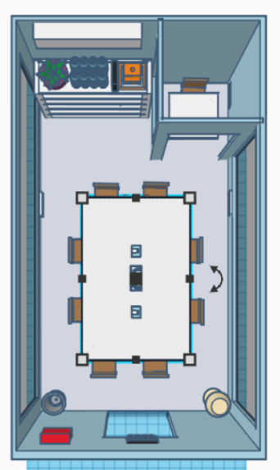
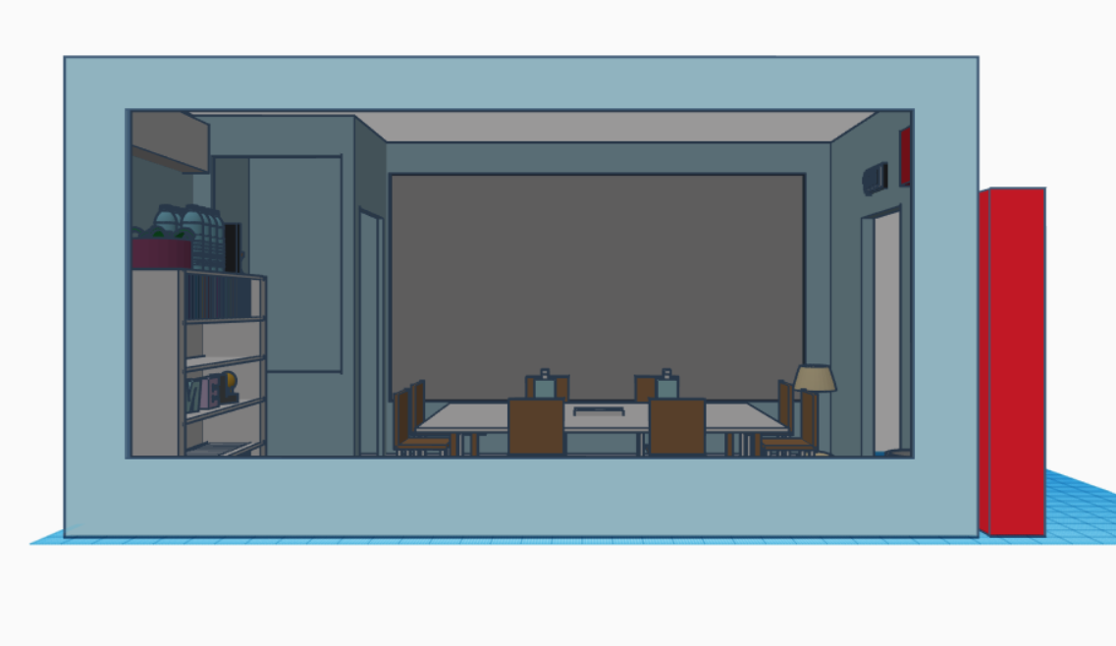
PROTOTYPE
Side view
Top view
Notes:
Jia Ning - Here are some pictures of our 3d study pod , the size will be 40ft by 20 ft and the left picture shows the top view while the picture on the right shows the side view

Slide 10
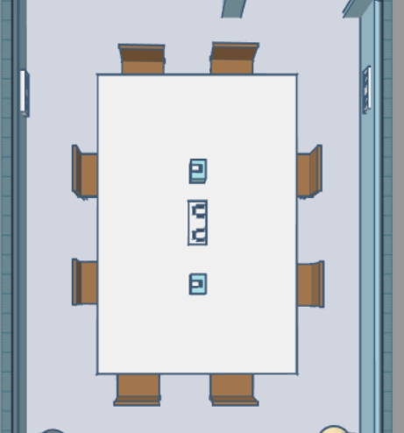
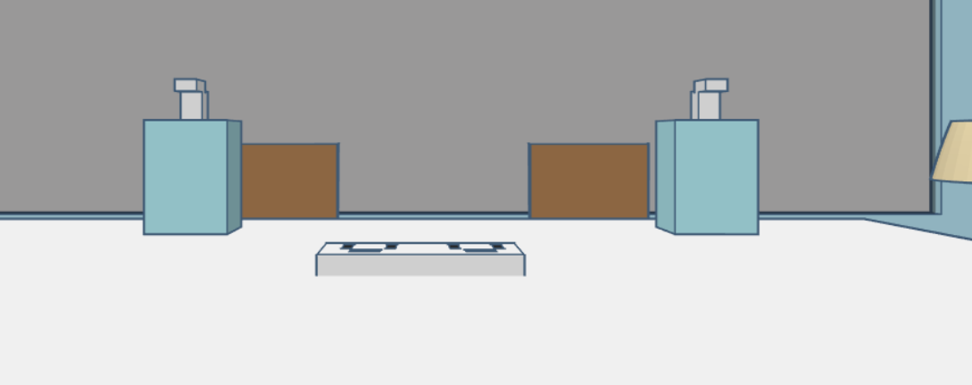
Hand sanitizers and charging ports are provided as well
There will be a large table with 8 chairs surrounding, in the middle of the room
Notes:
Jia ning- There will be a large table with 8 chairs surrounding, in the middle of the pod. We have also provided hand sanitizers and charging ports for the students to use. In total there are 8 charging ports that can be found in the pod

Slide 11
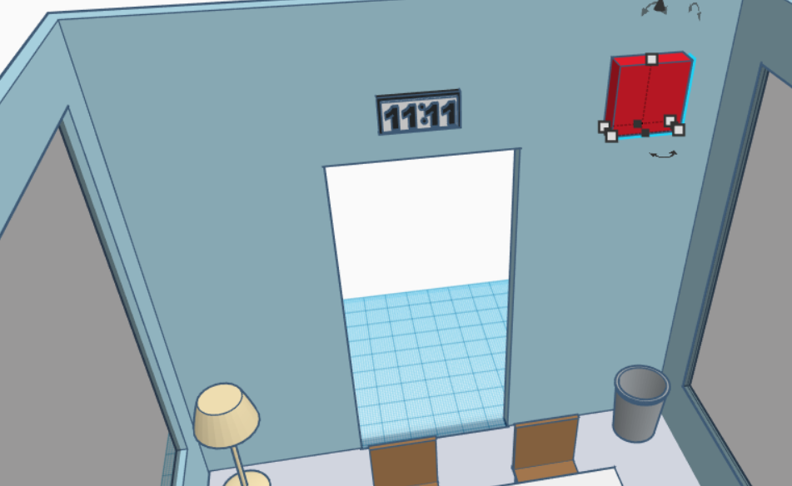
Digital clock available
The red block is to symbolize the fan.
Dustbin
Notes:
Jia ning- We have fans, digital clock , lamp as well as a dustbin for the students to dispose their rubbish.

Slide 12
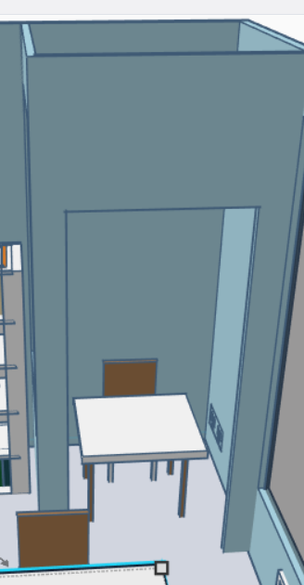
PRIVATE SPACE
Notes:
Jia ning- There is a small room located at the corner of the pod, this is for extreme privacy when the students need to speak in a zoom class or if they need to do a presentation. The students can also use this room if they need to be isolated from the rest to concentrate better.

Slide 13
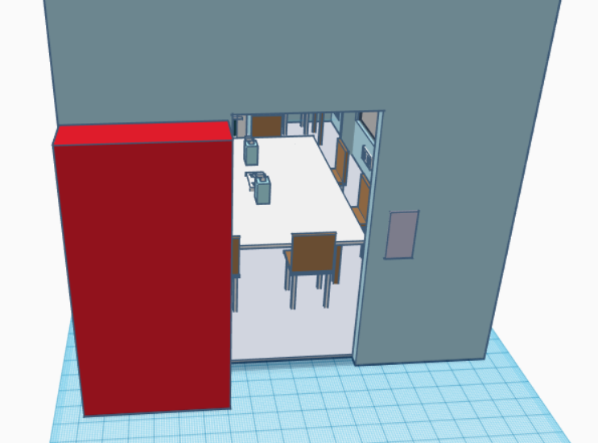
QR code scanner
Vending Machine
Notes:
Jia ning- Right outside the pod, a vending machine is available for use by the students as and when they feel hungry. Additionally, there will be a QR code scanner right outside the door so as to ensure students scan the safeentry before entering

Slide 14
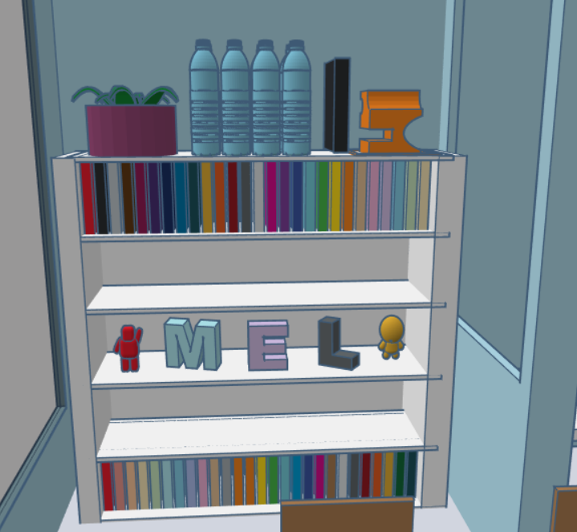
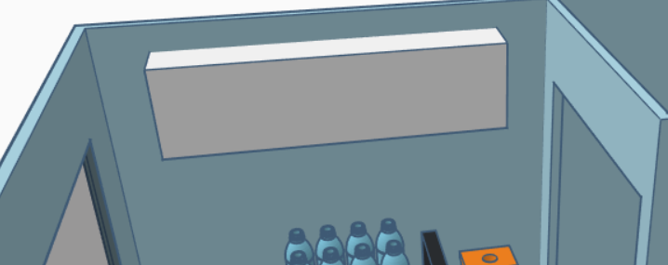
Complimentary water
Wifi
Books
Space for students
air-conditioner
Decoration
Notes:
Jia ning- Additionally we will be providing some complimentary water for the students if they need. As well as books and decorations to make this pod look more welcoming. We also have extra space provided in the shelves for the students to put their belongings there while theyre using the pod. RIght above the shelf we have the air conditioner

Slide 15
Additional information
Our Pod is environmentally friendly!!
Two-stage compressors on air conditioners which automatically compress less on cool days and more when is hot, saving energy
The air-conditioner will have a 2 hour timer and need at least 2 hours rest before using again
Programmable thermostats will be installed all over the pod
Notes:
Jia ning-I will now be sharing about some of the additional information of our study pod. We have made pod environmentally friendly by having two-stage compressors installed on air conditioners which will automatically compress less on cool days and more when it is hot, thus saving energy. In addition, the air conditioner also has a 2-hour timer which will turn off after the time is up, it will need at least 2 hours of rest before using again. Fans will be used during that period. Finally, programmable thermostat will be installed which would turn off any electronic devices when no one is around. This prevents energy to be wasted when there is no one inside.

Slide 16
Additional Information
Renting of Pod!
$2 Per Hour
Can rent only 3 times per week
Only up to 6 hours per rent
Location of Pods
Around 5-10 pods at North, South etc.
Community Centres.
Notes:
Jia ning- Now for the renting of the pod, it will cost $2 per hour and can only be rented 3 times a week by the same user. This is to prevent people from booking the pod for the entire week and causing others to be unable to use the pod. OUR FINAL GOAL is for The pod to be located at community centers and around 5-10 pods at different zones however we are planning to start at ngee ann polytechnic first to let our students experience this facility and give us feedback so that when we put it out for the public to use, it will be the best design possible. Now i will pass the time to my friends to talk about the study app.

Slide 17
STUDY APP
Notes:
Rachel - Accompanying the study Pod is a free app students can use to help facilitate their learning process.

Slide 18
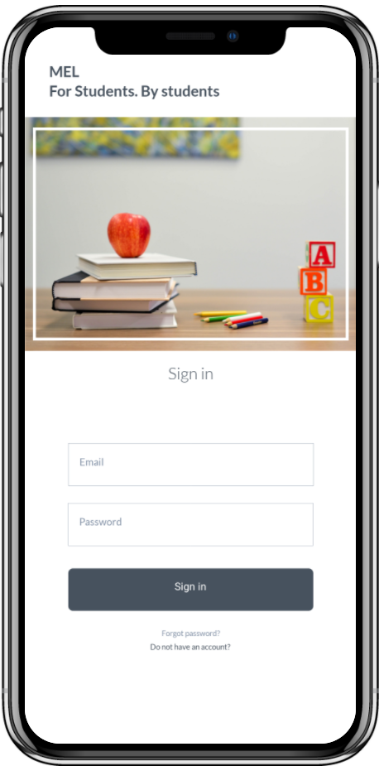
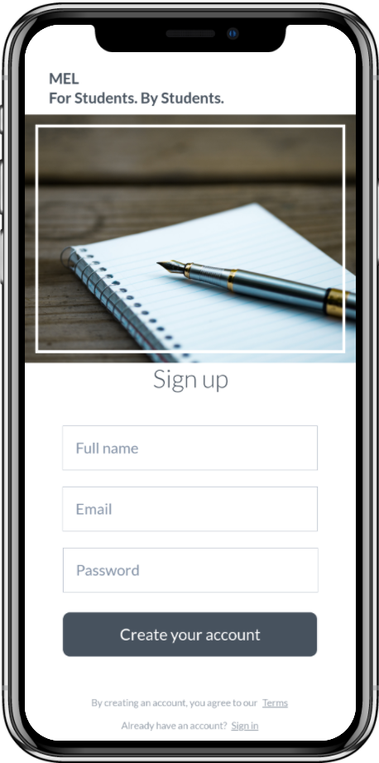
Sign In / Sign Up
Notes:
Rachel-So the moment u enter the app u will reach a page which will need to sign in to access your account and if u do not have an account u can just create it by pressing the “ do not have an account” button.

Slide 19
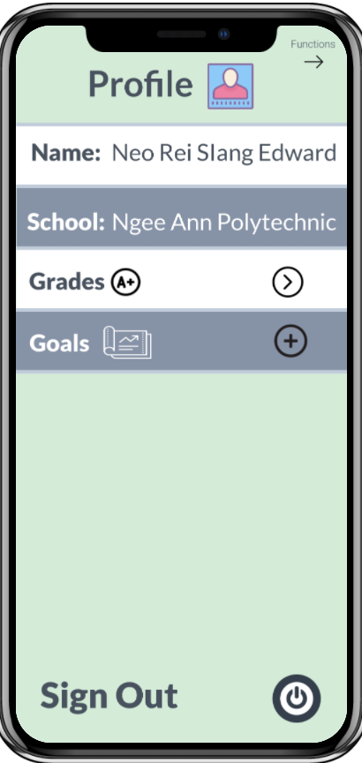
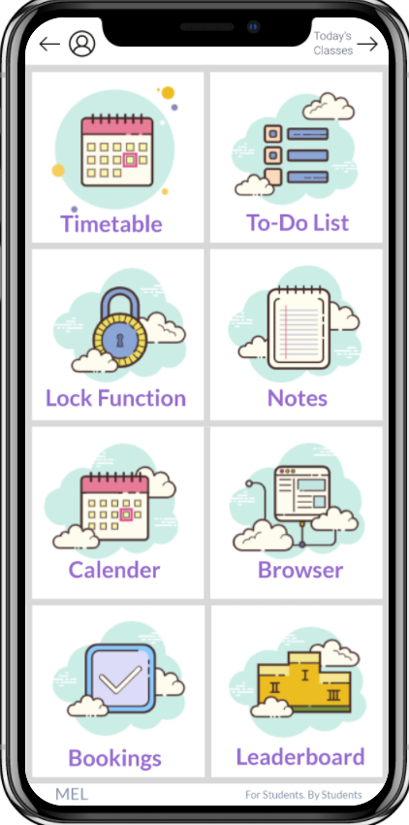
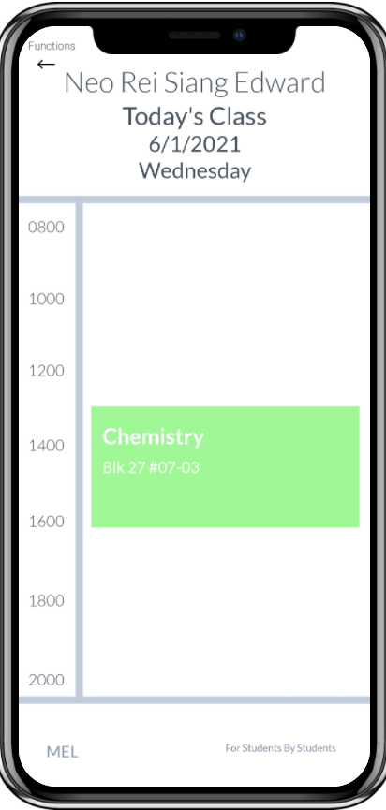
Home Page
Notes:
Rachel- After you sign in, the app will show you the features which is the middle photo. There are 8 functions users can use in this app.Users can check their profile by clicking on the left hand side of the page, and can also check for today’s lessons by clicking on the right hand side of the page.

Slide 20
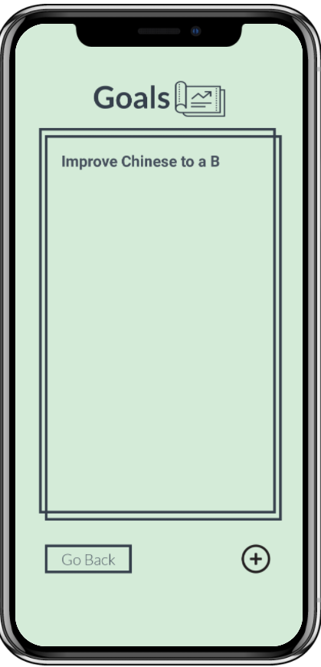
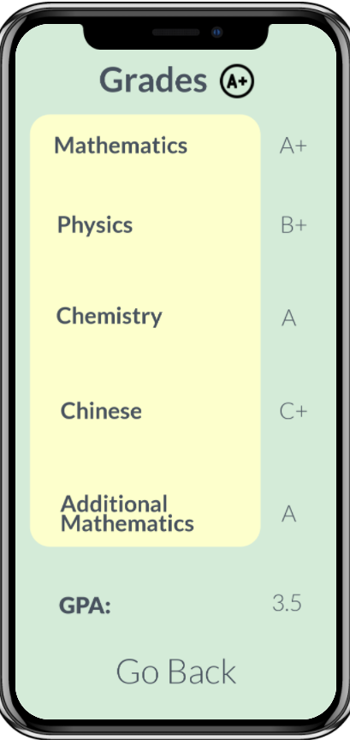
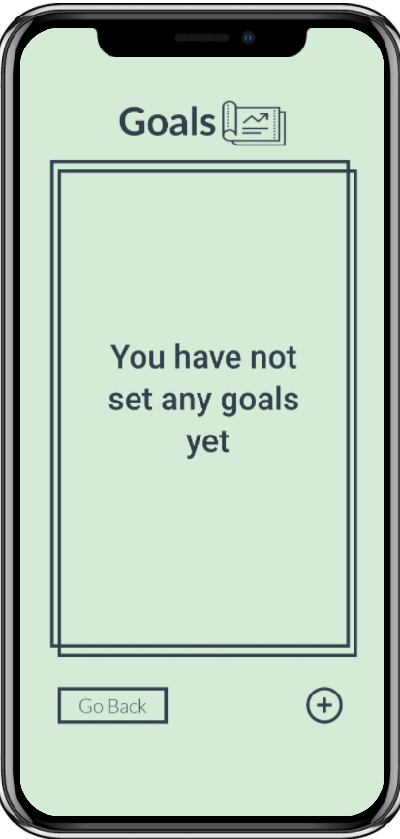
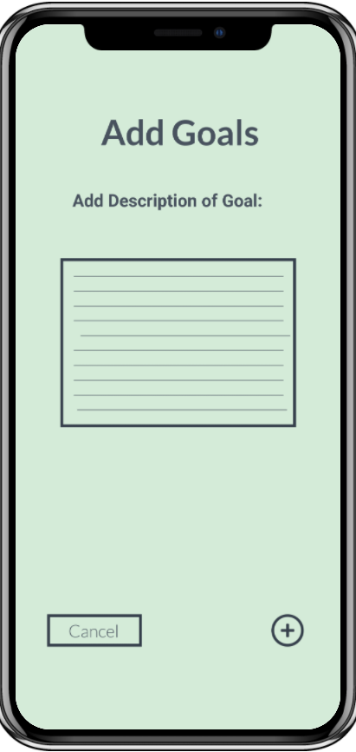
Profile
Notes:
Rachel- there is a profile function,which allows users to see their grades from last sem and maybe after looking at your grades, you may want to set some goals so for next sem u will have a goal to work for and keep you motivated. So u can add some goals as shown on the 4th photo and when you press the plus button at the bottom, ur goal will be saved onto the table shown on the 5th photo. After you are done with the app you can just sign out if not in use

Slide 21
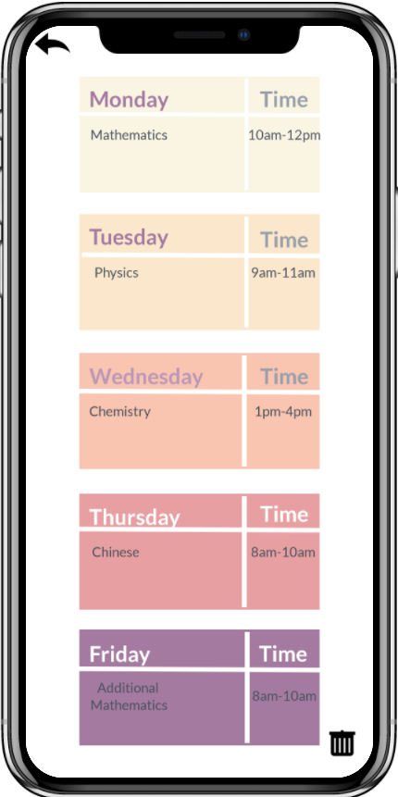
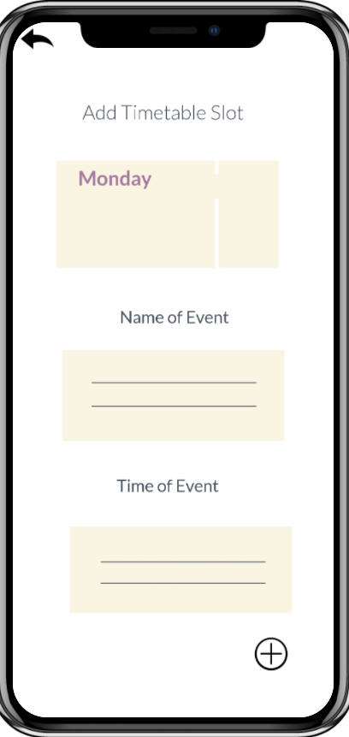
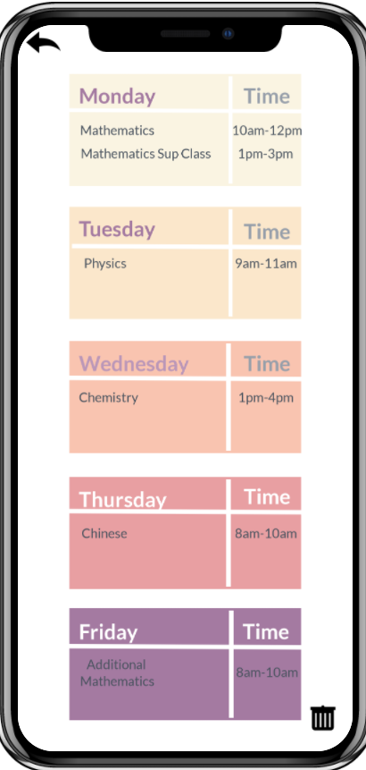
TimeTable
Notes:
Rachel-As for the main functions which begins with the timetable, students can view their weekly timetable which will help them keep track of their time and allow them to have better time management. Users have the option to add in a timeslot as they may have additional weekly classes such as supplementary classes.

Slide 22
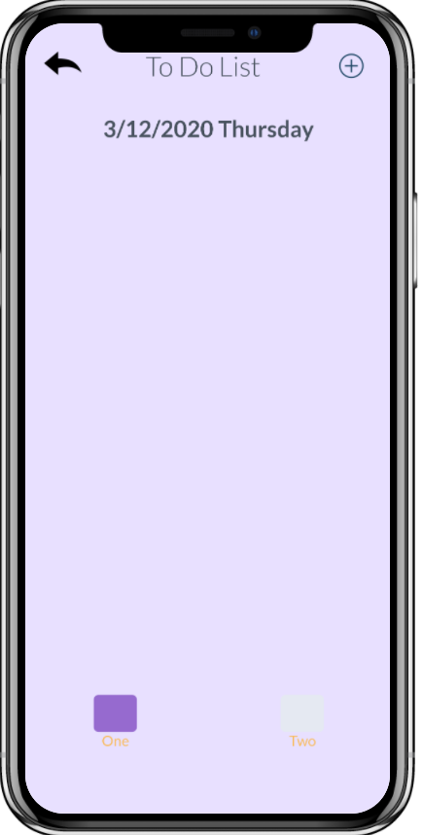
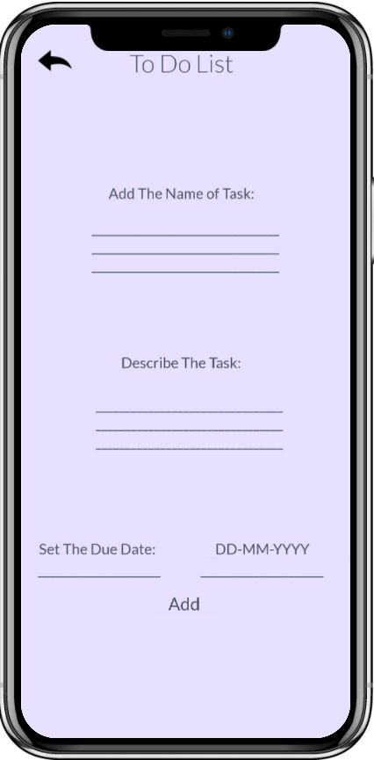
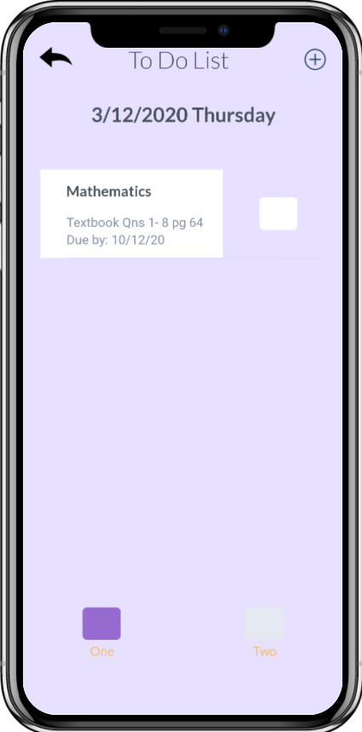
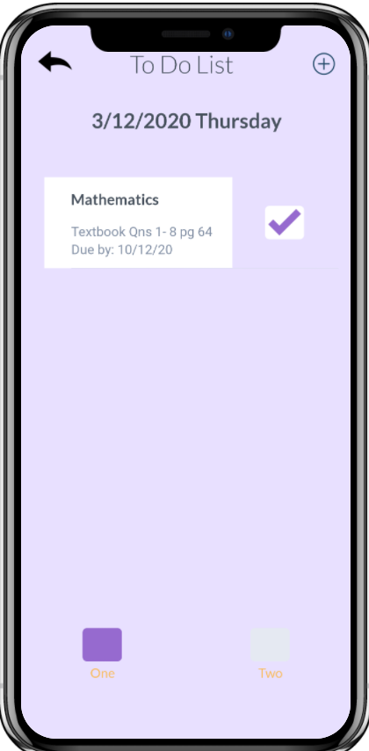
To-DO
Notes:
Rachel-Moving on, we have the to do list. Students can add in important tasks that needs to be done by a certain due date. After completing the task, user can click on the square icon beside the task and it will tick it. After the due date, it will automatically disappear.

Slide 23
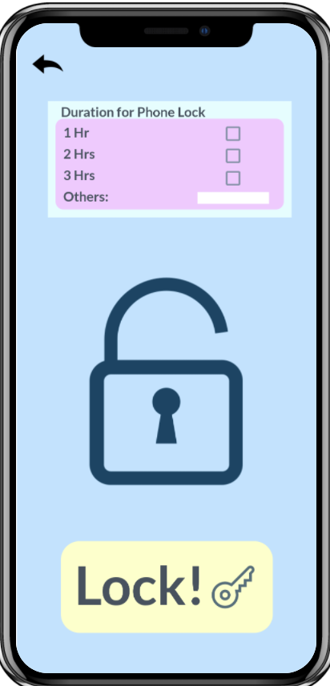
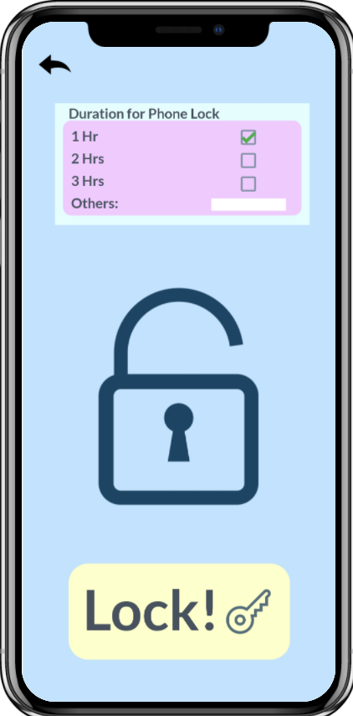
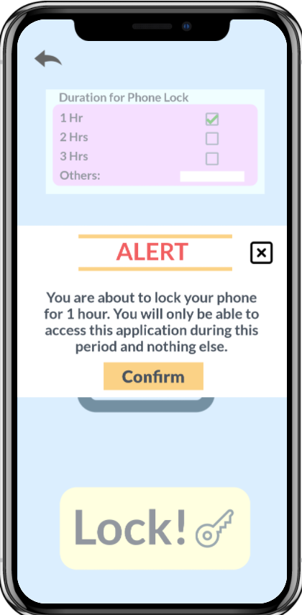
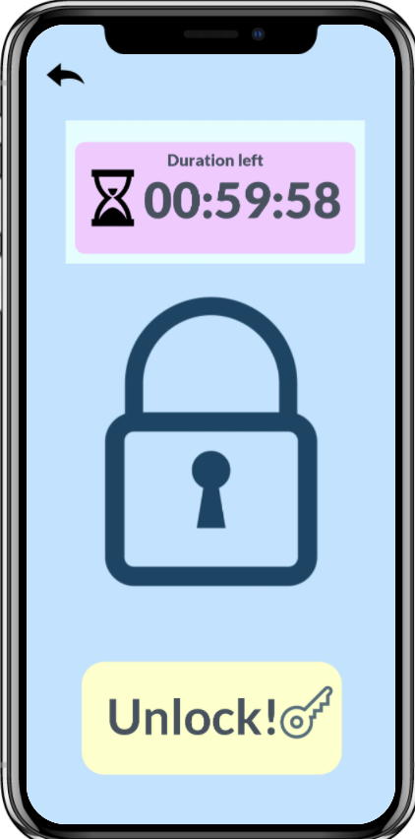
Lock FUnction
Notes:
Rachel-Next is the lock function. This function will lock the entire phone unless the user presses the unlock button and stop it before the time limit for emergency. For this function, the students can choose how long they want their phone to be locked for eg 1 hr or 5hrrs, after confirming a certain time the screen will pop up an alert notice and when the student presses on confirm, the timer will start.

Slide 24
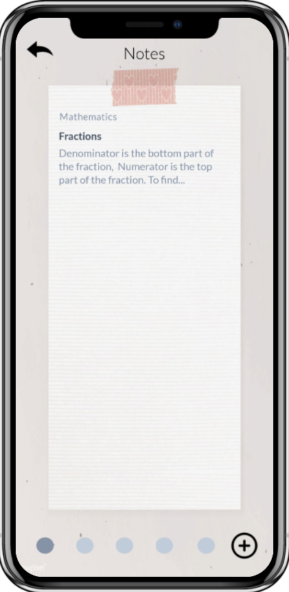
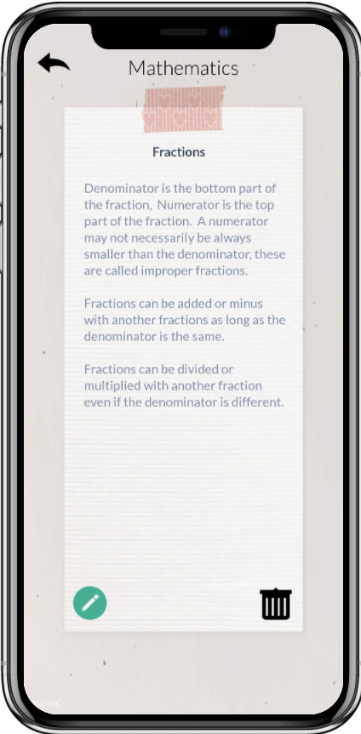
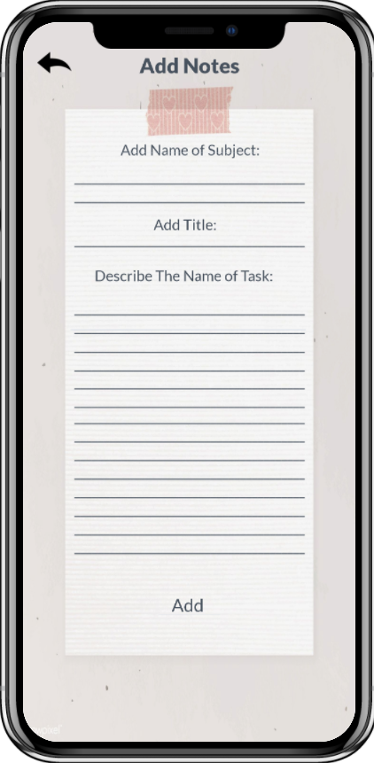
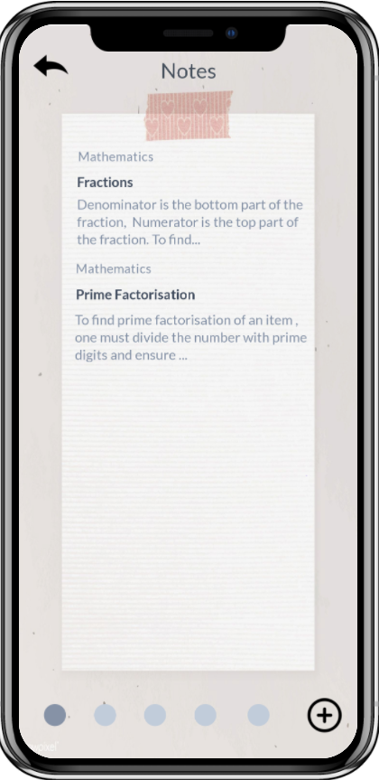
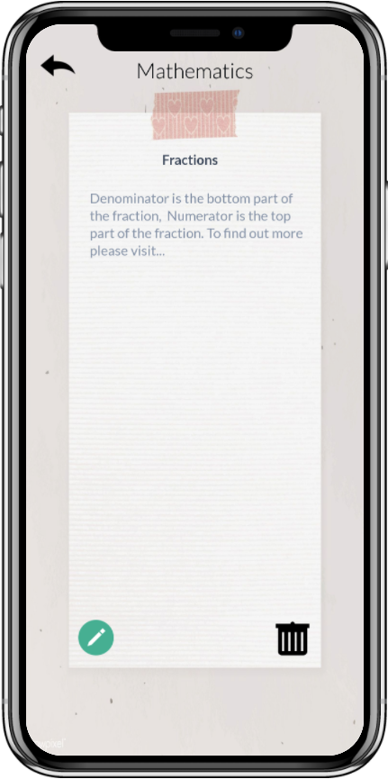
Notes
Notes:
Rachel-As for the Notes function, on default there are 5 pages of notes, but users can add more if needed. This allows users to categorise their notes according to subject which help facilitates the learning process. As shown on the slide, users can add in their notes, view and edit.

Slide 25
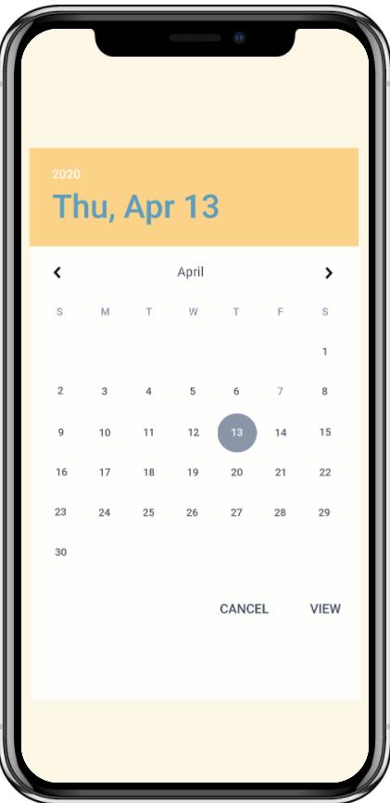
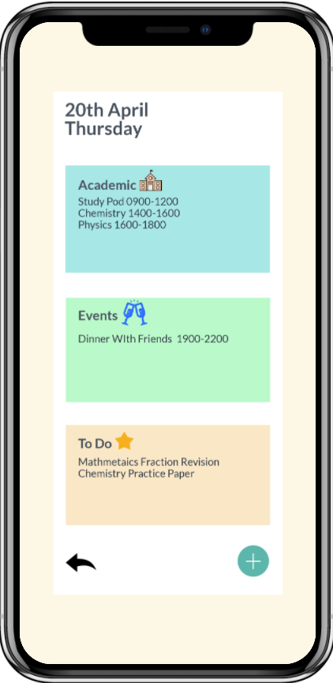
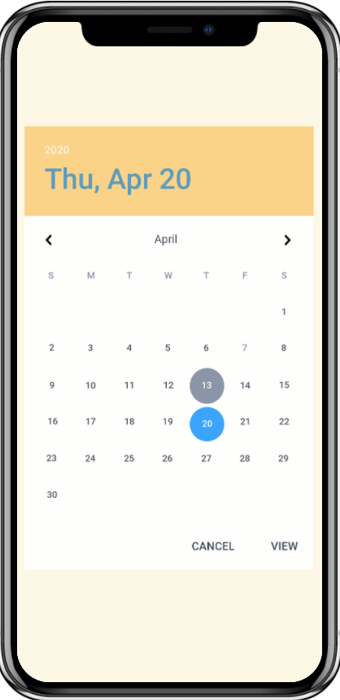
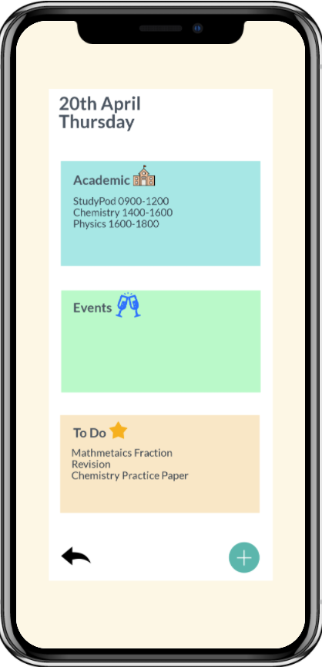
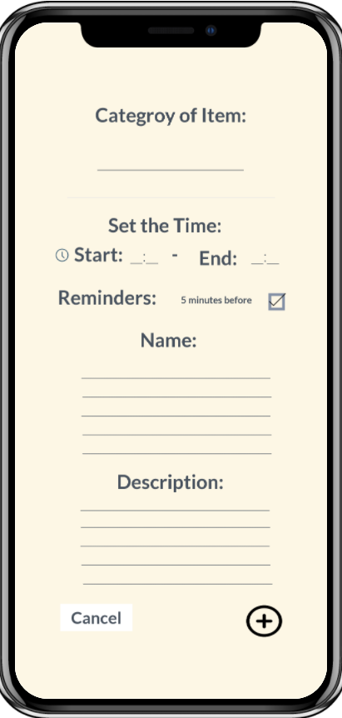
Calendar
Notes:
Rachel-For the calendar function it is unique because it links with the booking of the study pod, time table and the to-do list. The calendar is divided into three sections, academic, events, and To-do. Users can add items into each section. In the example above, we added an event “dinner with friends from 7 to 10, or if u booked the pod for a certain time it will also be recorded in your timetable, making it easier for you to manage your time.

Slide 26

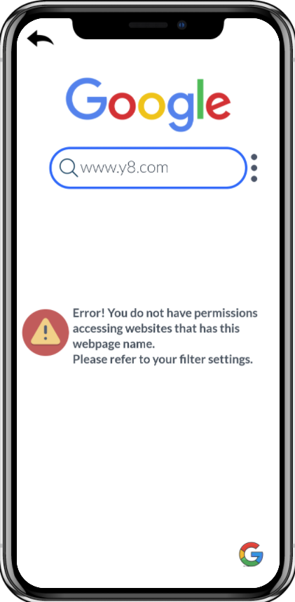
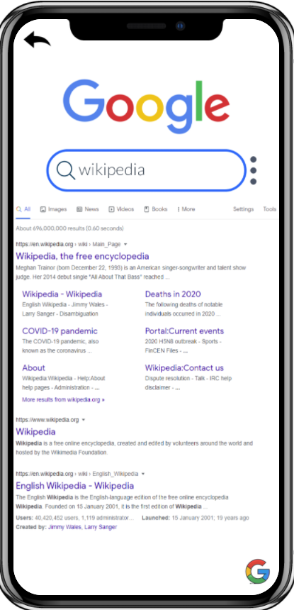
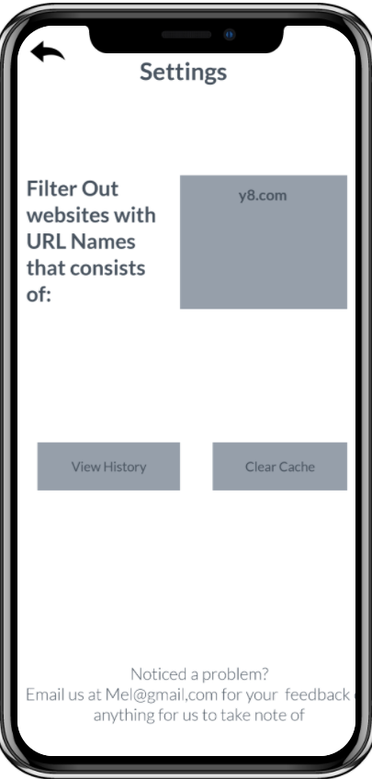
Browser
Notes:
Edward - Thank you Rachel, Now I will be moving on the browser function. The browser function is a little bit different from the chrome or safari your phones currently have as there is a special list of filtered words inside, where if users were to search webpages with names in this list, there will be an error. Our team felt that this function is important especially during locked mode, where users cannot use other apps. Thus this feature allows students to surf the web for more information, and at the same time prevent them from being distracted from entertainment websites.

Slide 27
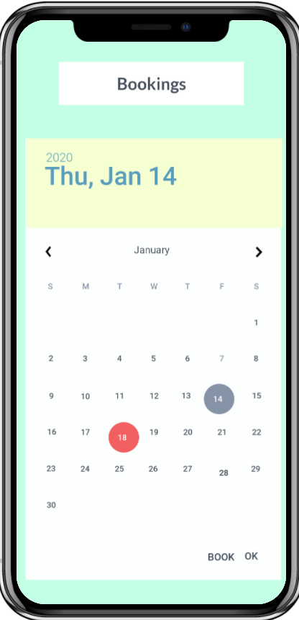
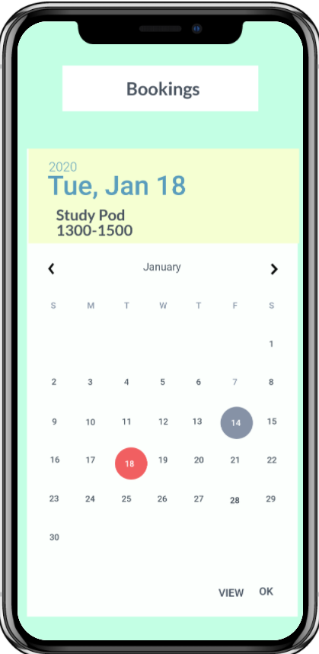

Bookings
Notes:
Edward - Moving on to the bookings function, users will be able to see the dates for this month and the dates that have been booked will be circled in red. Users can click on the dates to check the timing of the booking, as well as view the QR code needed for entry for the study Pod

Slide 28




Bookings(Process)
Notes:
Edward - When Booking for a timeslot on a date, users can choose a time from 8 Am to 12AM, as long as the time slot is available. The slots with a white background and an x in the middle indicate that the timing is unavailable. After confirming purchase, a QR code will be shown for confirmation of order.

Slide 29




Bookings(Wallet)
Notes:
Edward - There is also a wallet function in bookings which shows the current balance in the wallet. Users can add amount to the wallet if needed. Below are some examples of the payment methods available. After adding an amount,($20) for example, when user goes back to bookings the time, it will be updated.

Slide 30





Leaderboard
Notes:
Edward - For the last function, the leaderboard function, Users can create a league or join a league. After being in a league, users can click on the league name to access the rankings in the league. Users are ranked based on the total points accumulated. 10 points are earned every hour in locked mode.

Slide 31




Leaderboard(Redeem)
Notes:
Edward - With the points gained, users can use the points to redeem rewards. Users can choose to either redeem vending machine items or book a slot in the Study Pod. Choosing vending machine items will allow them to redeem a wide variety of drinks and snacks for a certain amount of points. For booking of a slot, users can redeem up to a maximum of 4 hrs and each hr cost about 100 points

Slide 32




Leaderboard(Rewards)
Notes:
After redeeming a vending machine items, the points will be deducted and users can click on rewards to view the items they have redeemed. After clicking on the item name, a Qr code will appear and users can use the QR code to redeem items.

Slide 33





Leaderboard(StudyTime)
Notes:
Edward - If users are booking a slot for the Study Pod. They will go through the same process as the bookings section and can choose a date and timing they want. Except, instead of having a wallet amount at the top right, it will be the hrs left to redeem.

Slide 34
Overview of Functions
Display of Timetable
To-do List
Notes Jotting
Phone
Lock
Calendar
Browser
Bookings
Leaderboard
Notes:
Edward - So to give an overview of our app, our app has 8 functions. The Displaying of TimeTable, To-Do List, Phone Lock, Notes Jotting, Calendar, Browser, Bookings and Leaderboard functions. Our Team strongly believes that with this app , as well as the study pod, we will be able to help students achieve the best studying environment they want.

Slide 35
THANK YOU
Notes:
Edward - And with that, we thank you for listening.

